Slide 1

WildLifeGuide
Exploring the World of Amphibians and Insects

Slide 2
Table of content
The idea
The EDA
Data Preperation
The model
Conclusion
Questions

Slide 3
The idea
Different kind of species
Amphibians
Insects
Arachnida
Reptilia
Take a picture of the species
Information about the species (dangerous?)
Reason why the species is dangerous

Slide 4
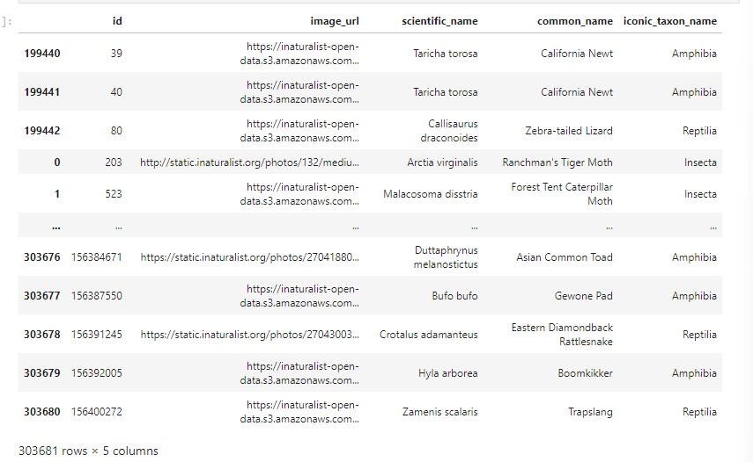
EDA - Dataset
Observations of every species around the world.
Cleaning the data.

Slide 5

EDA - Visualize
Visualize the distribution of iconic tacon name
Top 10 most common Species

Slide 6
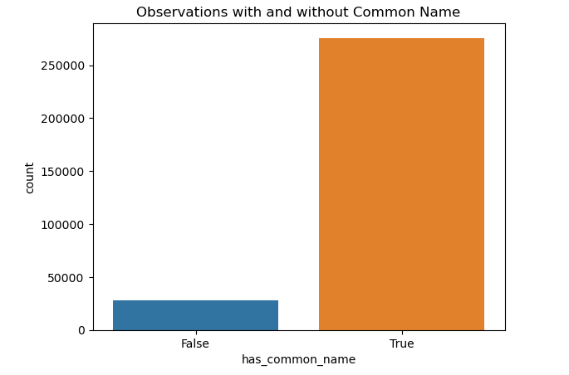
Data preperation
Checked and filled in empty values in this dataset
Removed duplicated rows
Changed dutch names into english names
Adding new columns wheter the species is dangerous and why it is dangerous

Slide 7
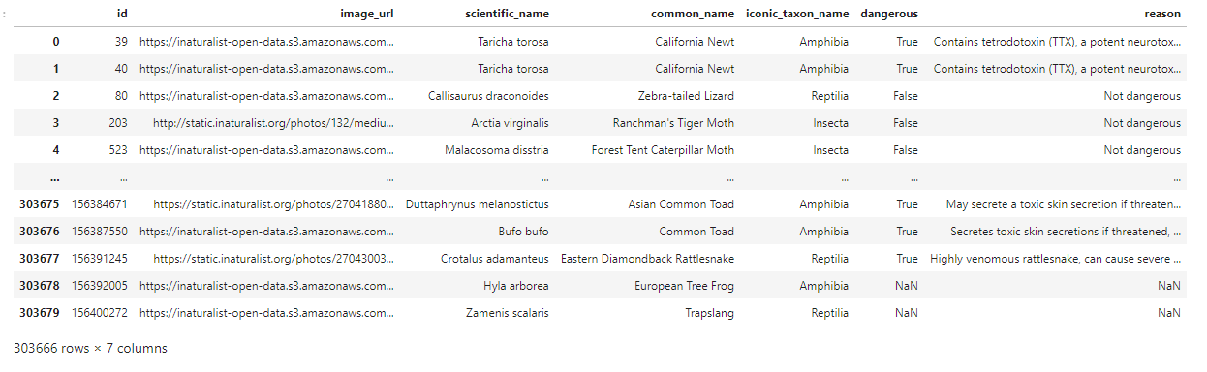
Data preperation

Slide 8
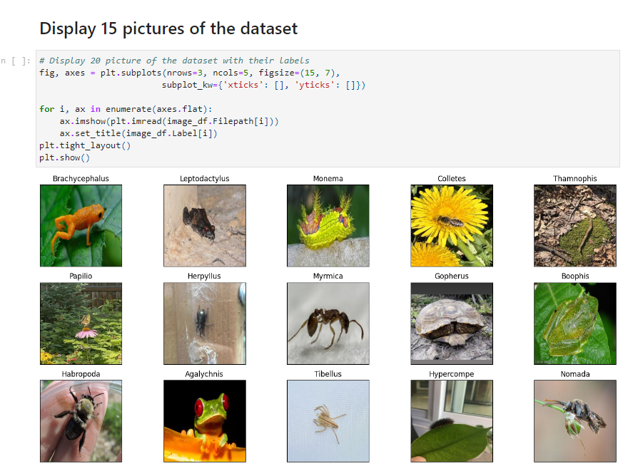
Model

Slide 9
Model
Loaded the pre-trained model (MobileNetV2)
Added a custom layer with softmax activation.
Train and evaluate the model

Slide 10
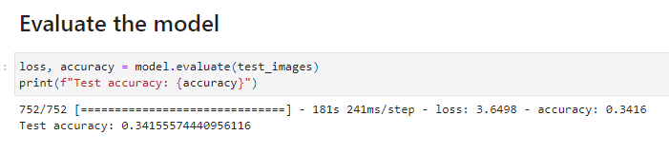
Model
Accuracy 34%
Overfitting
Model accuracy is increasing.
Validation accuracy was not improving.
Validation loss was increasing.

Slide 11
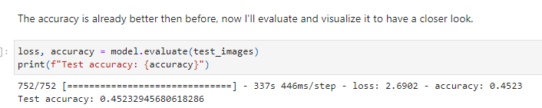
Model
Remove rows with observation < 50
Data Augumentation (random transformation)
Learning rate
Fine-tuning the model
Accuracy of 45%

Slide 12
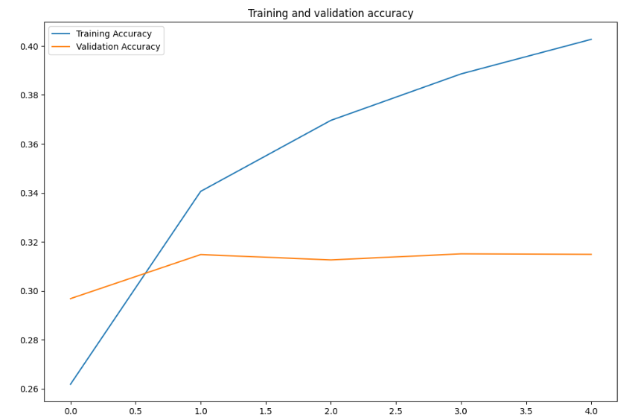
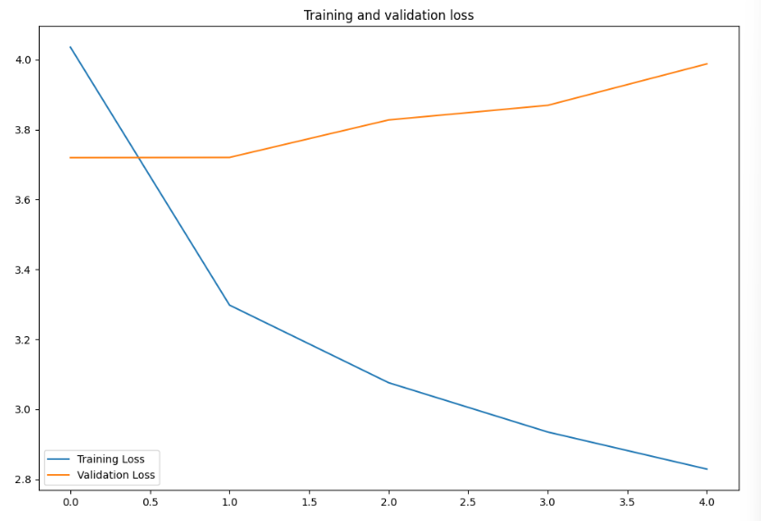
Model
Model has learned the training data too well
It is capturing not just the underlying patterns but also the noise and the outliers
Again overfitting.

Slide 13
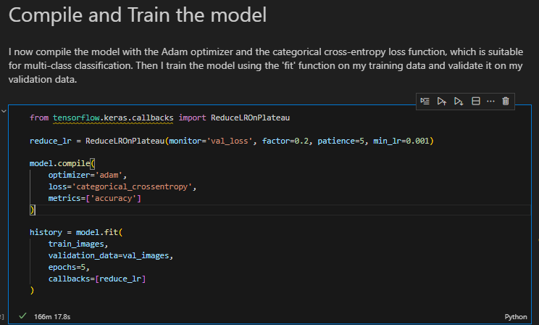
Model
Training the model took me 166 minutes.

Slide 14
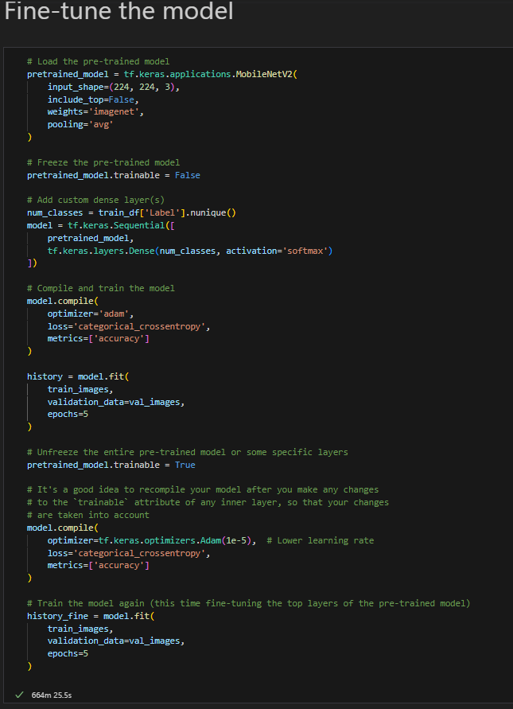
Model
Fine-tuning the model took me 644 minutes.

Slide 15
Conclusion
The training time on everage was 13.5 hours.
Takes a long time to change a small thing in the model
Problem is probably in the dataset (not enough observations)
CPU?
Not enough knowledge to create an application.

Slide 16
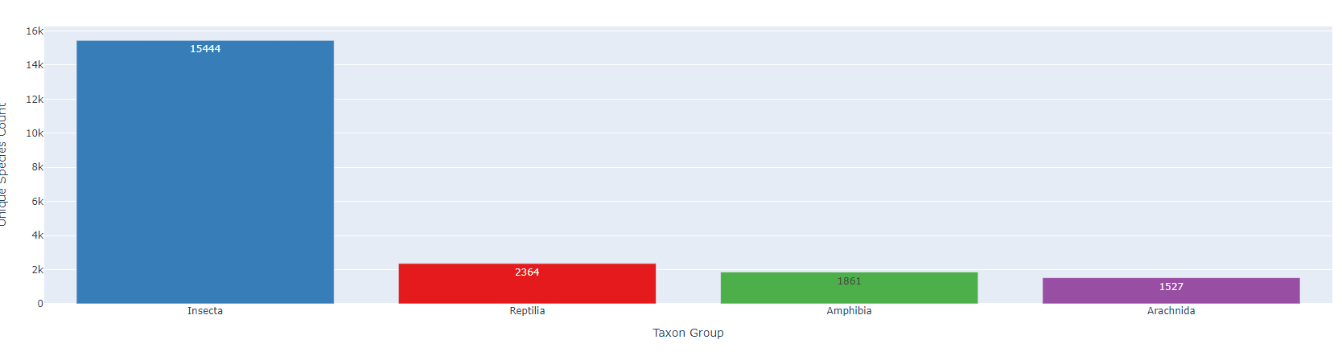
Conclusion
Remove half of the insect column
Remove all observations less then 100
Train on only 1 taxon group at a time
Get my GPU running

Slide 17

Questions or tips?

